Slide 1
Miniproject 3: Banking Clientele Segmentation
Albina Mussilova
Niklas Bergen
August 13, 2021
Notes:
Nik
Zain’s comments on Miniproject 3:
Analyse dataset for bias (e.g. more male data than female) and pick equal amount of data
Anurag’s comments on Miniproject 2:
Real-life data science projects typically are at least 3 months
No code at all, or screenshots from Jupyter labs
Don’t make your audience work for your visualizations
Evaluate presentation from this perspective: “you are an owner of a company, and somebody presents you this presentation”.
Focus on the big picture and the business problems you are solving. (How does the business earn money?)
Practice talking to non-technical audience (how to explain API to a 5 year-old)

Slide 2
Outline
Objective
Methods Used
Results
Challenges
Notes:
Nik

Slide 3



Objective
Identify targetable marketing groups
Credit card user
Credit limit increase
Long-term saver
Investment plan
Notes:
Nik
These are hypotheses!
Could also offer loans to credit card users
Could convince long-term savers to get a mortgage

Slide 4
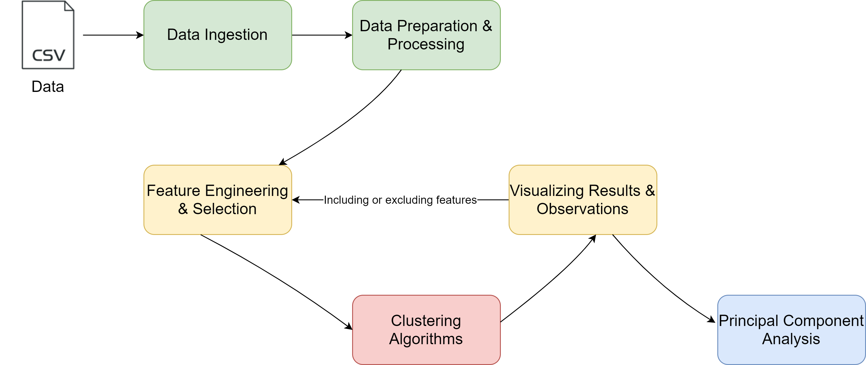
Objective
Workflow
Notes:
Albina

Slide 5

Methods Used
scikit-learn
MinMax
MaxAbs
Standard
Robust
KMeans
Agglomerative
DBScan
Jupyter Lab
Scaling
Clustering
Notes:
Nik

Slide 6
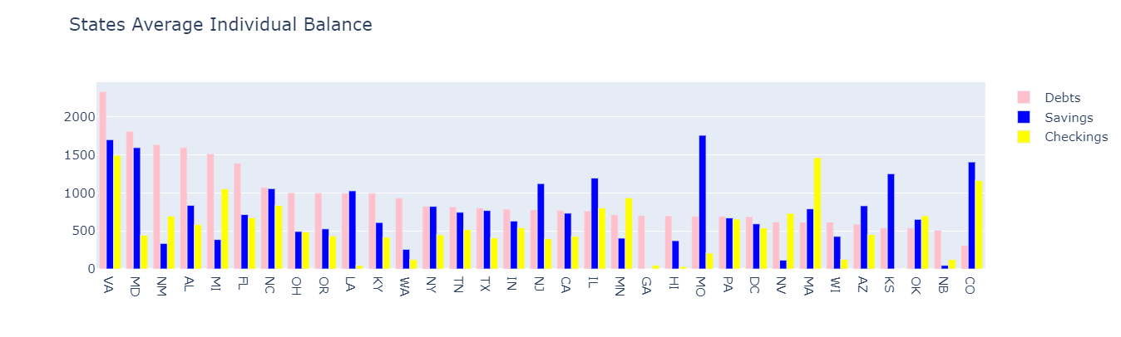
Results
Initial analysis:
Insights
Can potentially avoid debt-prone states
Target states with high checking averages to open savings accounts
Notes:
Albina

Slide 7
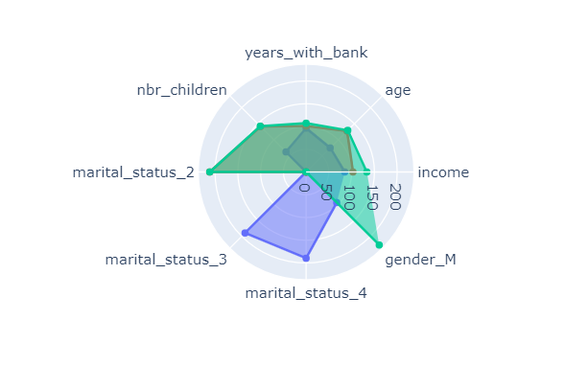
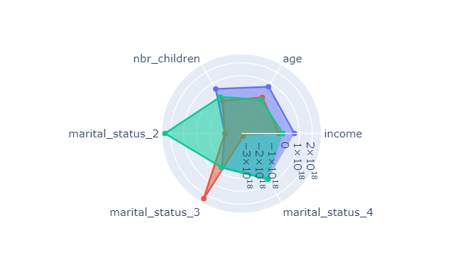
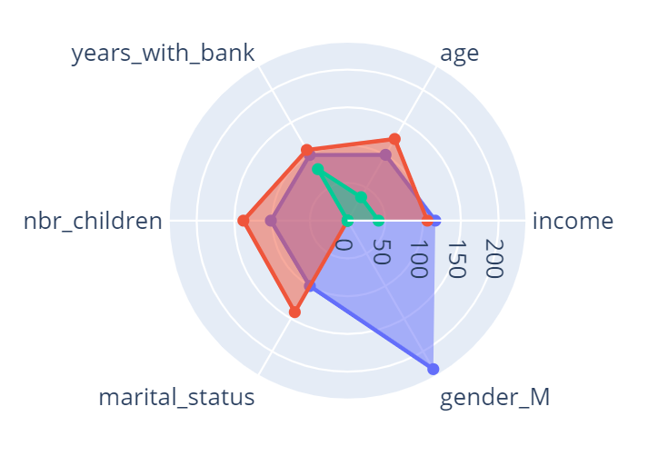
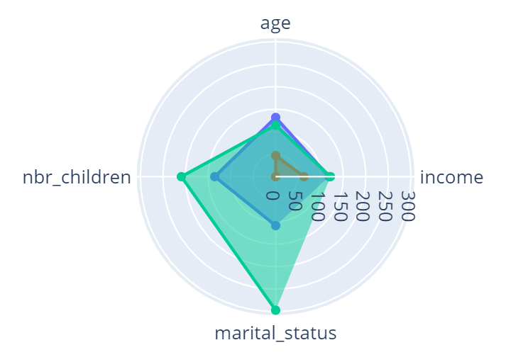
Results
Based on demographics:
MinMax, Aggl., n = 3
Standard, KMeans, n = 3
Insights
Income is skewed based on gender
Could have special offers for women to increase business
Extend interest free period on credit cards
Target long-term plans for clients with kids
Average Income
F 19834
M 26406
Notes:
Albina
Cluster A1: gender and income
Cluster A2: marital status/children/years with bank/age
Cluster B: marital status & children

Slide 8
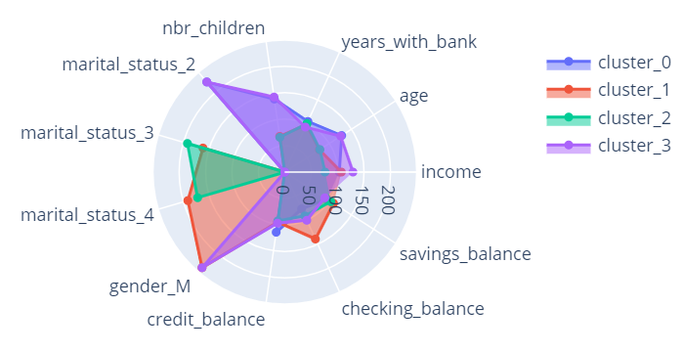
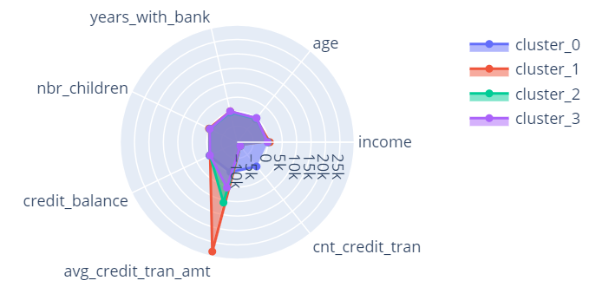
Results
Based on banking habits:
MinMax, KMeans, n = 4
Robust, KMeans, n = 4
Insights
Target checking users to create a savings account
Target avid credit card users with credit limit increase
Notes:
Nik
- Opening a savings account would increase customer satisfaction and business levels since they would be earning interest

Slide 9
Challenges
Feature selection/engineering
Limited database information
Notes:
Nik
- Improve clustering, avoid overlap
Database could include:
More data overall
Nationality, occupation, education, interests

